Slide 1
UPSC CSE Mains 2024
Mathematics
- Bhavna Khurana

Slide 2
Overall Assessment of Mathematics Paper 2024
Paper 1, Section A: Easy if studied well. Questions – straightforward.
Paper 1, Section B: ODE was unconventional, lengthy. Physics – straightforward.
Paper 2, Section A: Modern Algebra was direct. Overall Easy.
Paper 2, Section B: PDE again unconventional. Physics – easy.

Slide 3
Paper 1

Slide 4
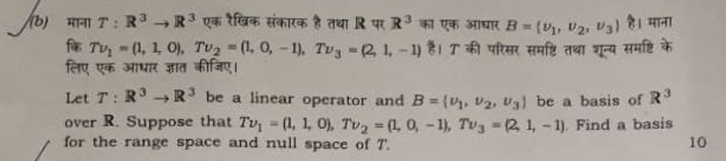
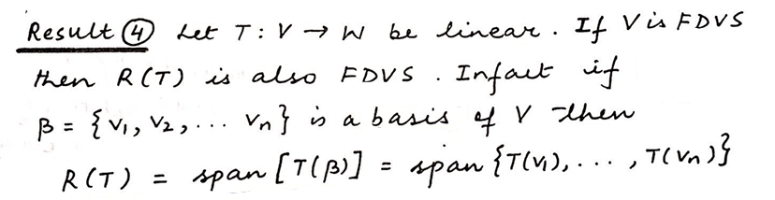
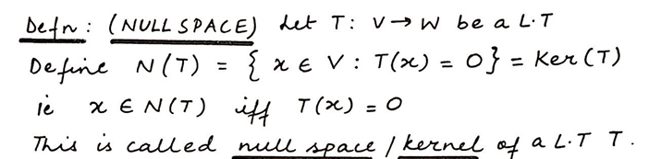
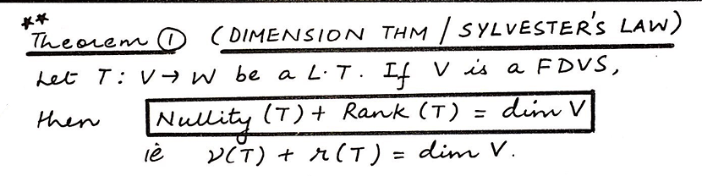
Q1(b)
From
Notes

Slide 5
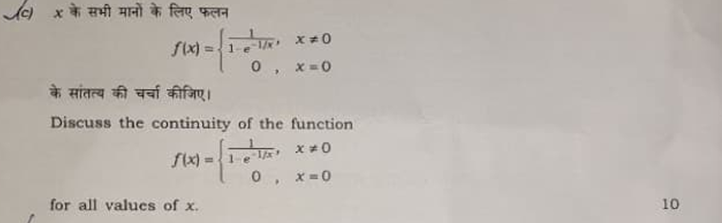
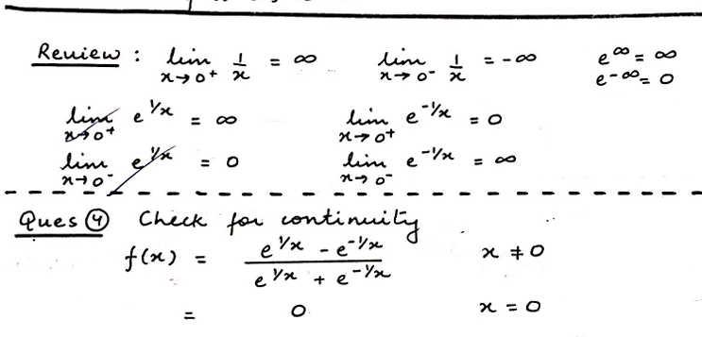
Q1(c)
From
Notes

Slide 6
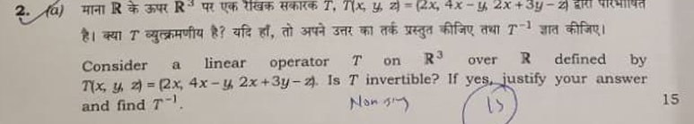
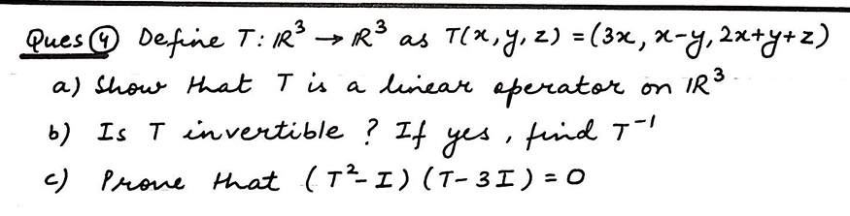
Q2(a)
From
Assignment

Slide 7
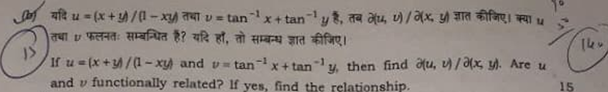
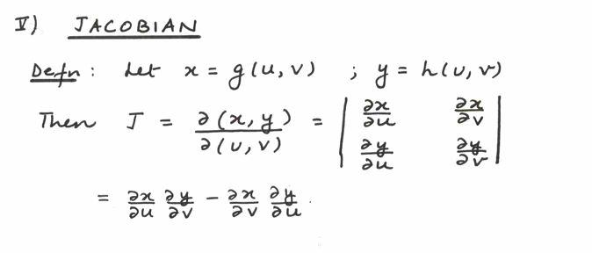
Q2(b)
From
Notes

Slide 8
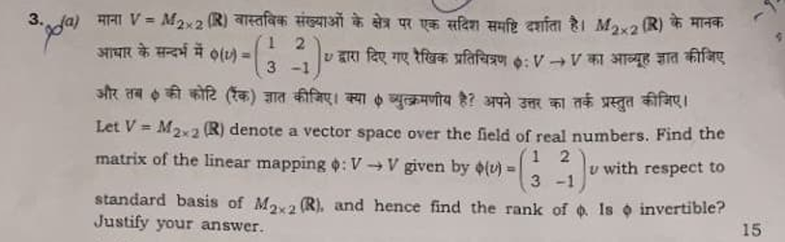
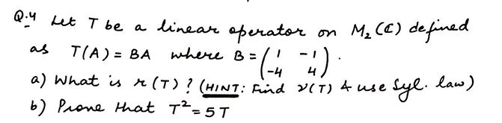
Q3(a)
From
Assignment

Slide 9
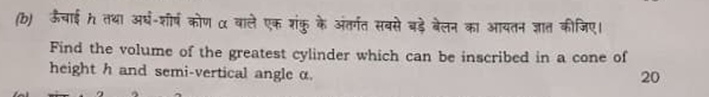
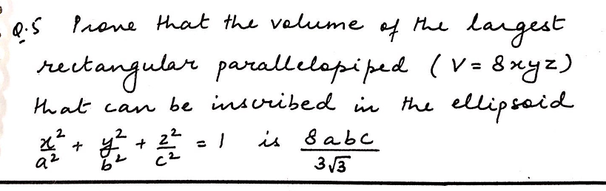
Q3(b)
From
Assignment

Slide 10
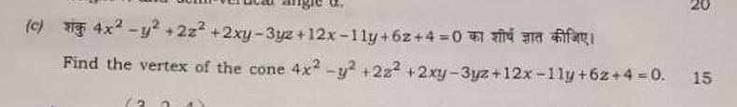
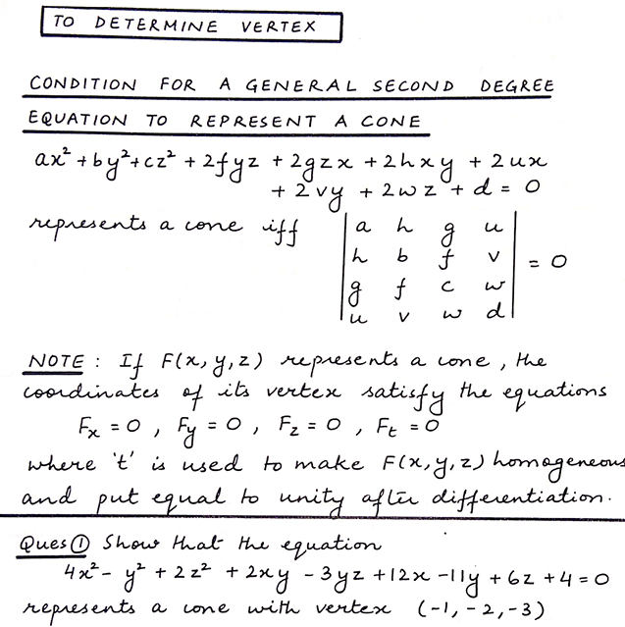
Q3(c)
From
Notes

Slide 11
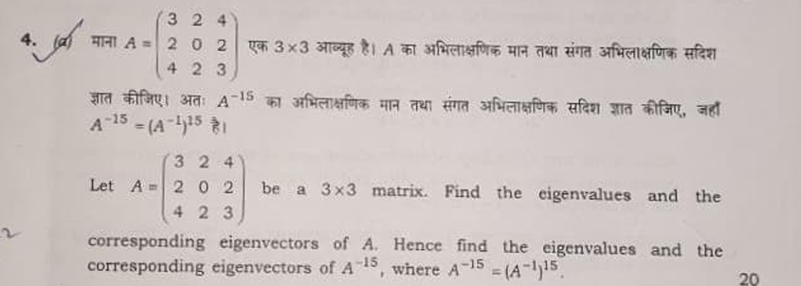
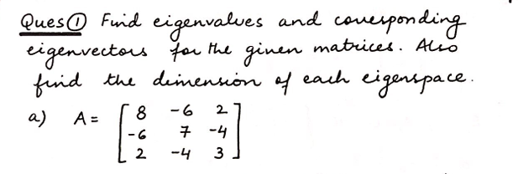
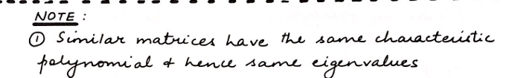
Q4(a)
From
Notes

Slide 12
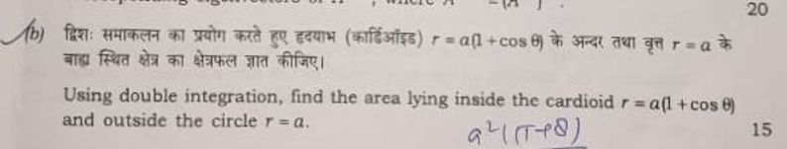
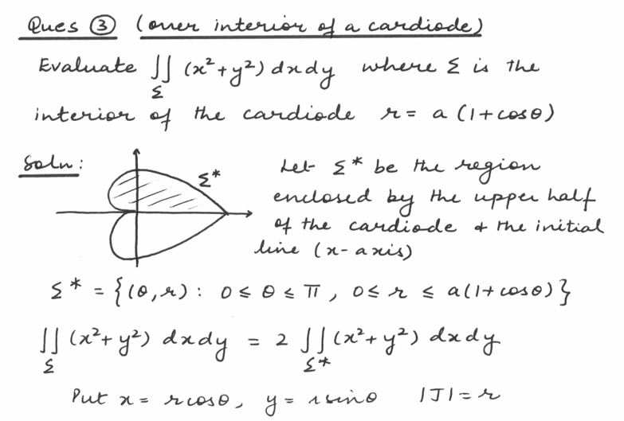
Q4(b)
From
Notes

Slide 13

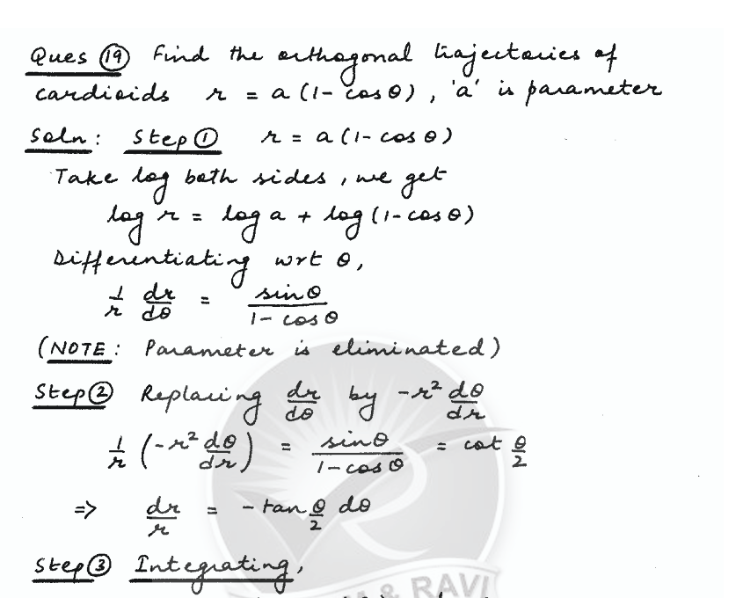
Q5(a)
From
Notes

Slide 14
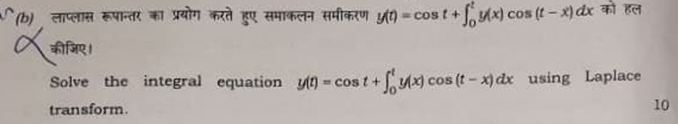
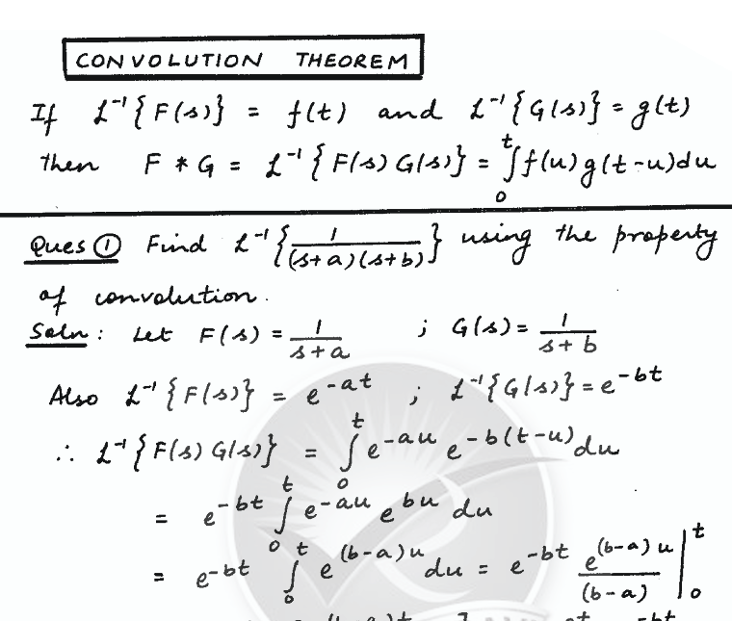
Q5(b)
From
Notes

Slide 15
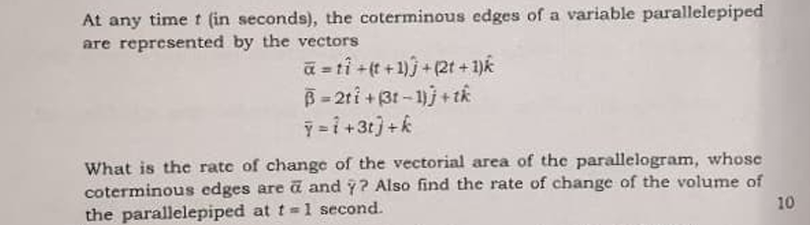
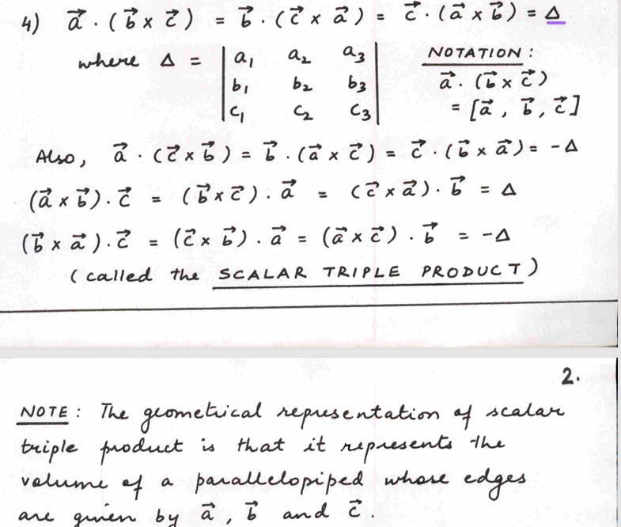
Q5(c)
From
Notes

Slide 16
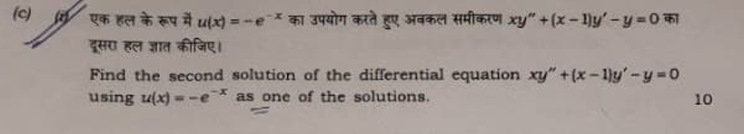
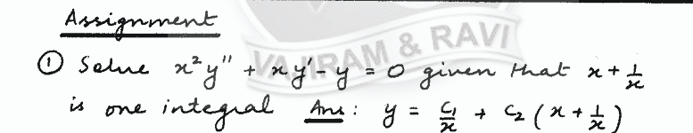
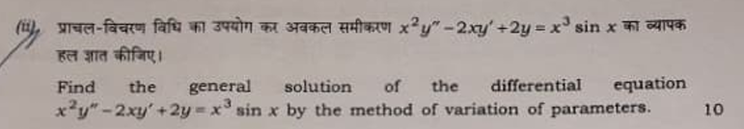
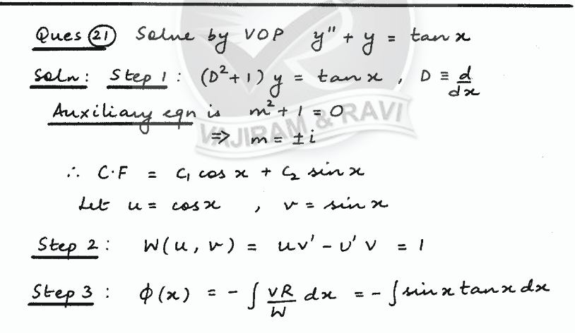
Q6(c)
From
Notes

Slide 17
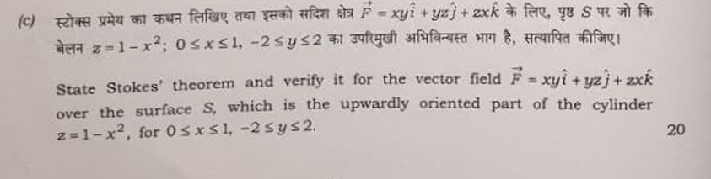
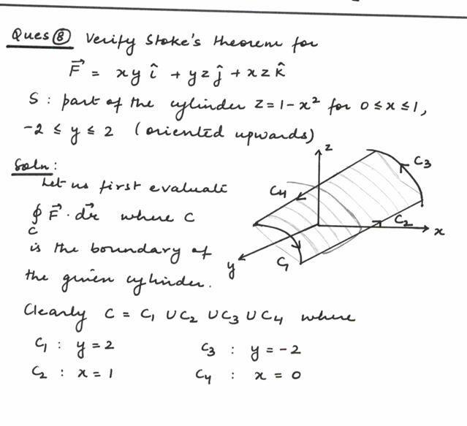
Q7(c)
From
Notes

Slide 18
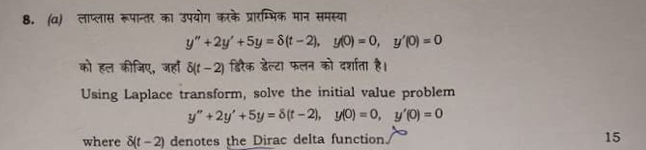
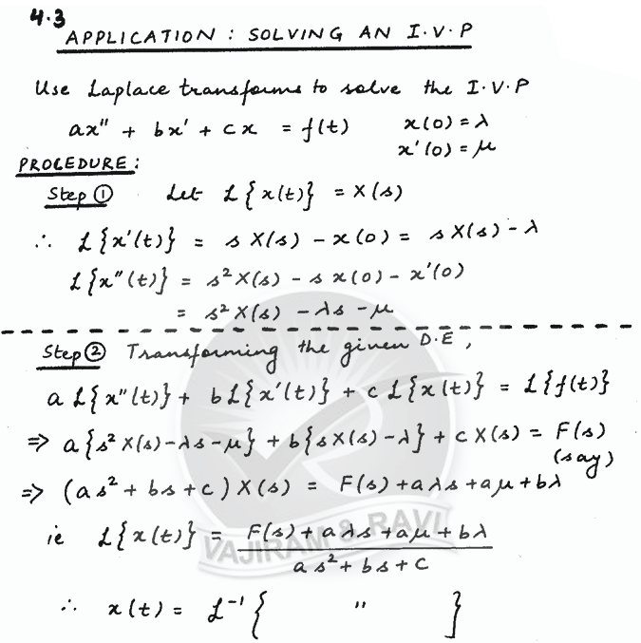
Q8(a)
From
Notes

Slide 19
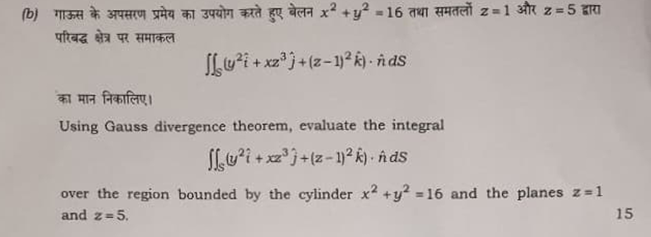
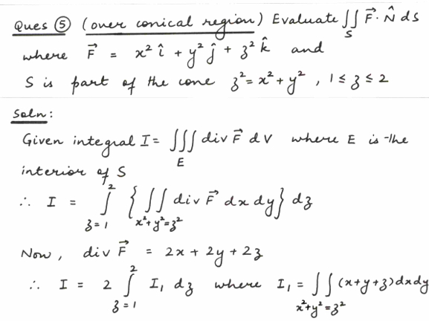
Q8(b)
From
Notes

Slide 20
Paper 2

Slide 21
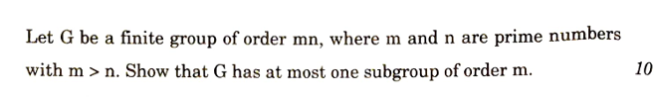
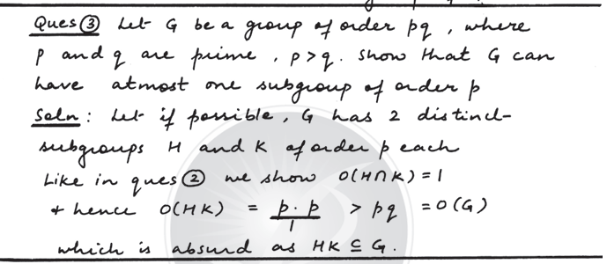
Q1(a)
From
Notes

Slide 22
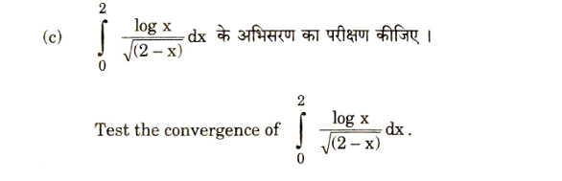
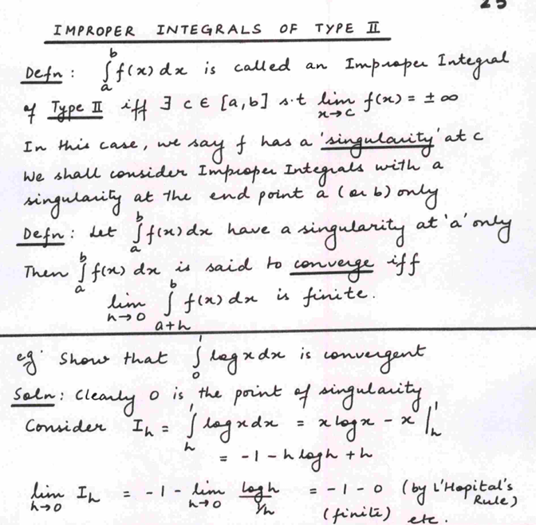
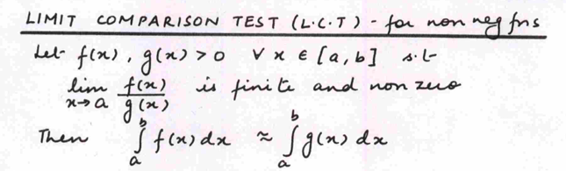
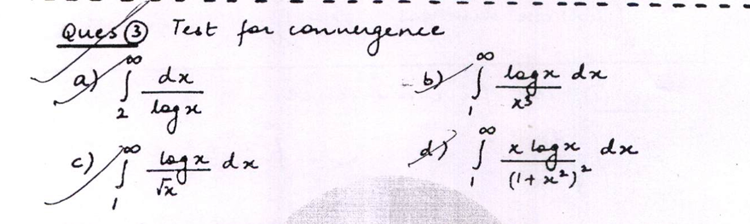
Q1(c)
From
Notes

Slide 23
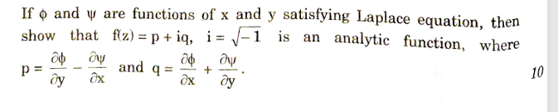
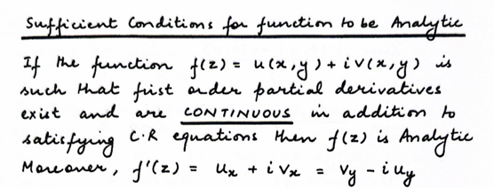
Q1(d)
From
Notes

Slide 24
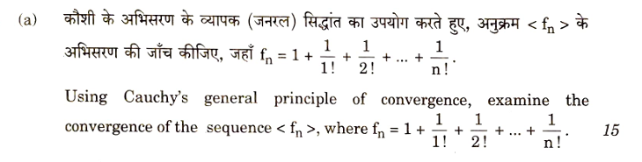
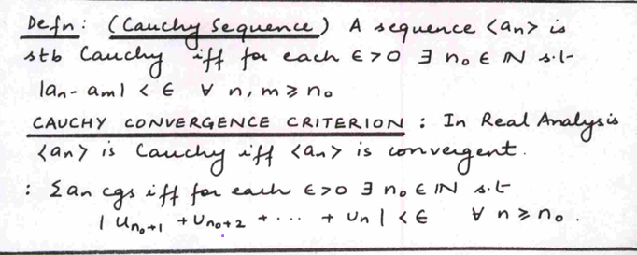
Q2(a)
From
Notes

Slide 25
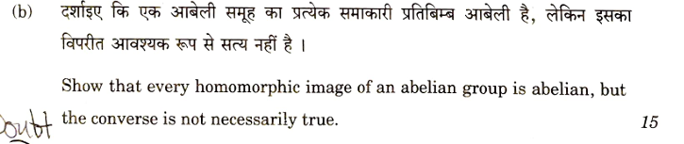

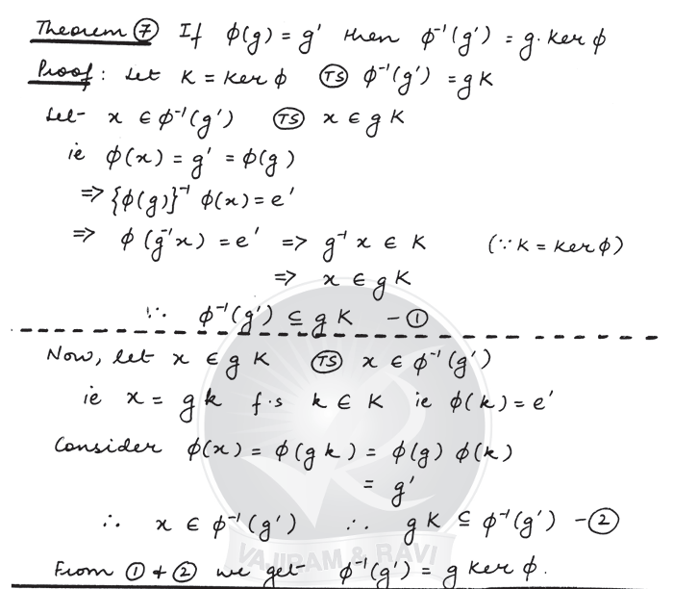
Q2(b)
From
Notes

Slide 26
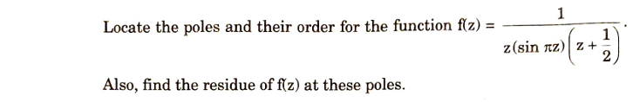
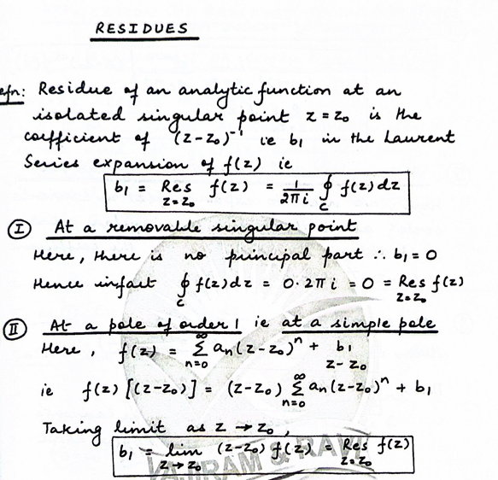


Q3(a)
From
Notes

Slide 27



Q3(b)
From
Notes

Slide 28


Q3(c)
From
Notes

Slide 29



Q4(a)
From
Notes

Slide 30



Q4(b)
From
Notes

Slide 31


Q4(c)
From
Notes

Slide 32


Q5(b)
From
Notes

Slide 33


Q7(a)
From
Notes

Slide 34


Q7(b)
From
Assignment

Slide 35


Q8(b)
From
Notes

Slide 36
Thank You

