Slide 1
UPSC Mains 2024

Slide 2
Paper 1

Slide 3
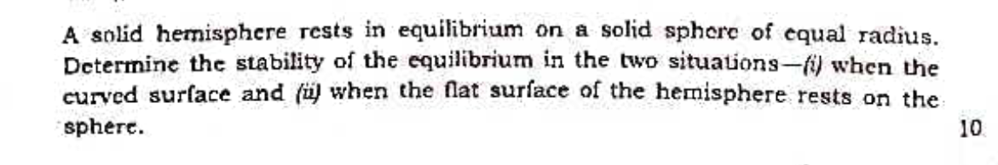
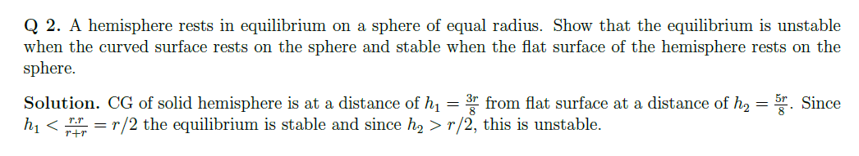
Identical question from Practice Problems
Stability of Equilibrium

Slide 4
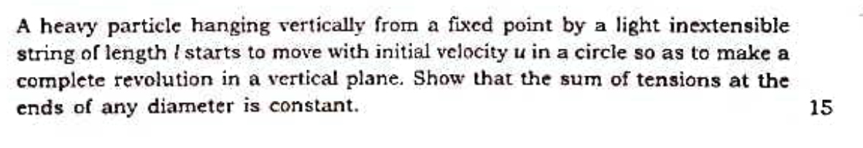
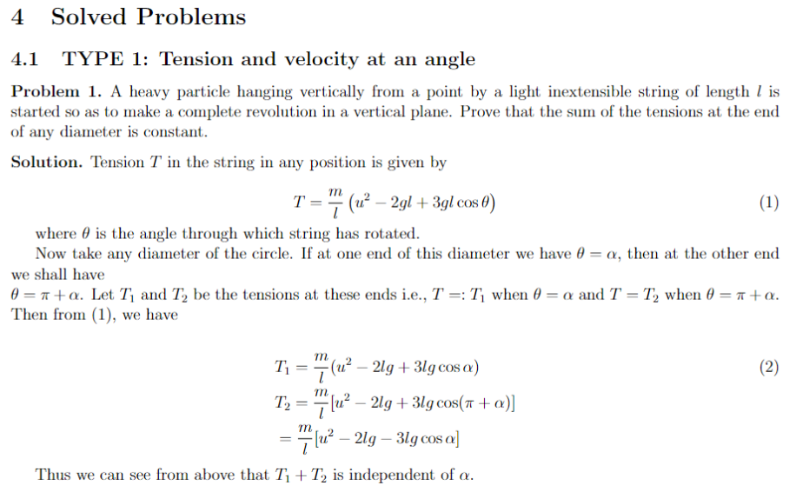
Identical question from Solved Problems
Constrained Motion (Vertical Circle)

Slide 5
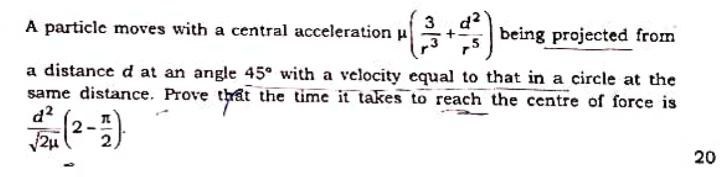
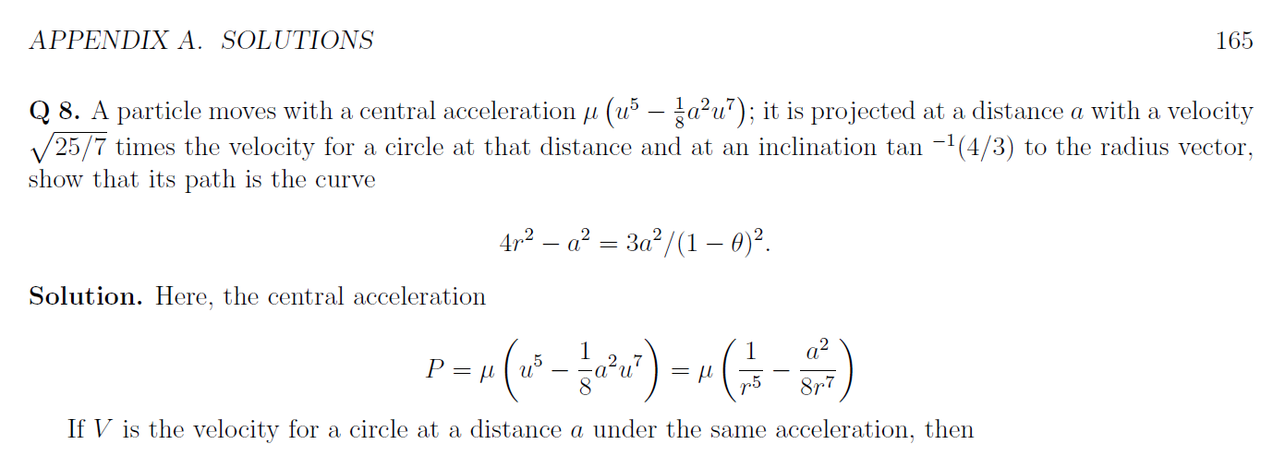
Almost similar Question from Practice Problems
Motion under Central Force

Slide 6
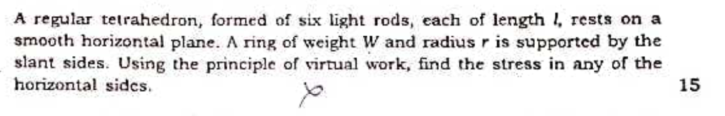
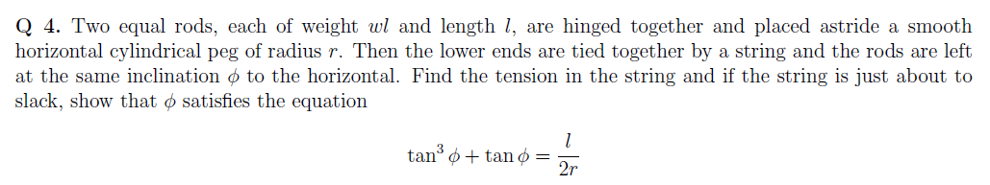
The concept to be applied in this question is similar although setting is different
Virtual Work

Slide 7
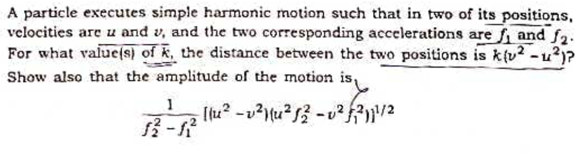
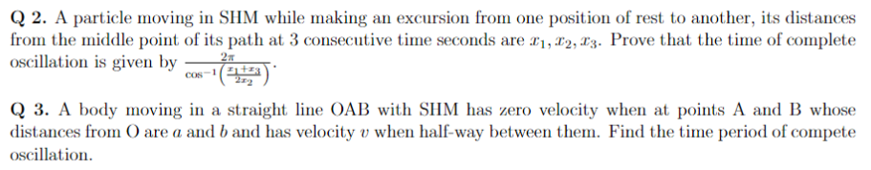
The concept to be applied in these question is similar
Simple Harmonic Motion

Slide 8
Paper 2

Slide 9
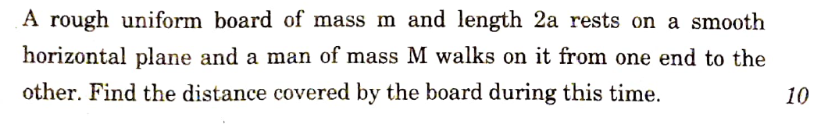
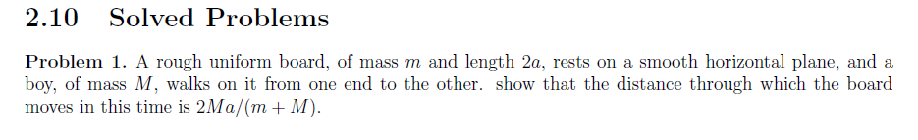
Identical from Solved Problems
D’Alembert’s Principle

Slide 10
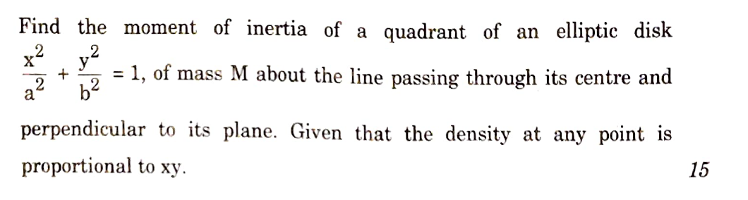
Almost Identical from Solved Problems
Moment of Inertia

Slide 11
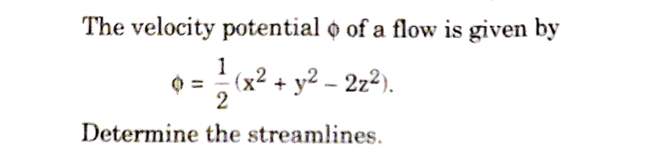
Identical from Practice Questions
Streamlines and Potential FLow

Slide 12
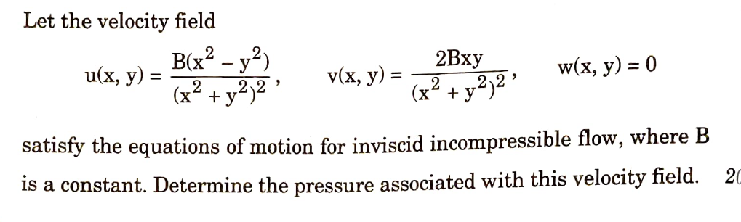
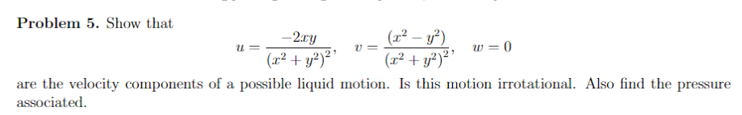
Identical from Solved Problems
Euler’s Equation of Fluids Motion

Slide 13
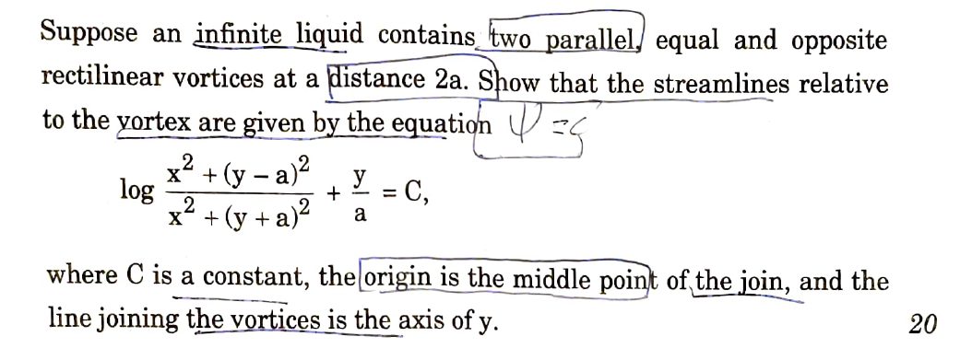
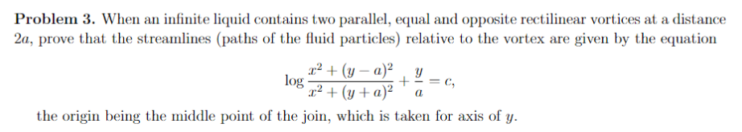
Identical from Solved Problems
Vortex Motion

